Slide 1


Natural gas v alternative routes for production of chemicals in 2022
Institute for Chemical and Bioengineering
Sustainable Process Systems Engineering Lab
Abhinandan Nabera
22. September 2022

Slide 2
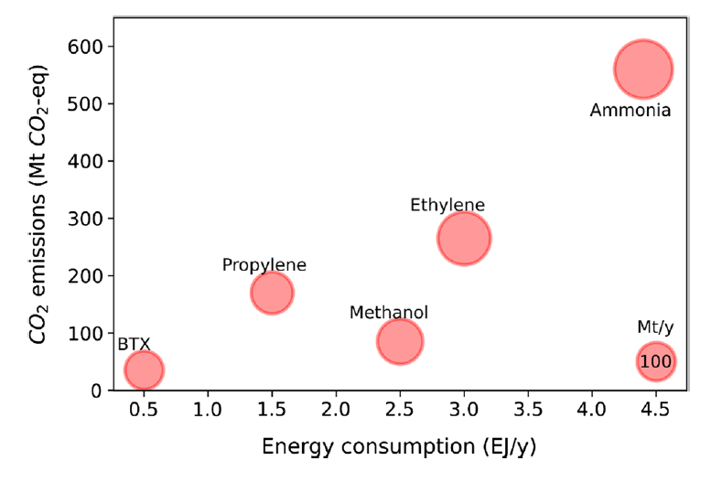
Ammonia and methanol are the most energy intensive chemicals

Slide 3
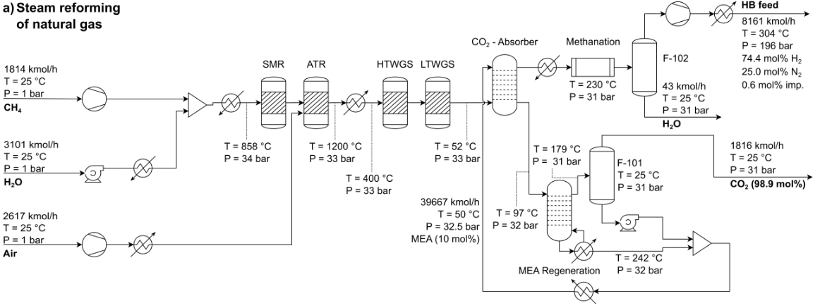
SMR and WGS for the production of conventional hydrogen

Slide 4
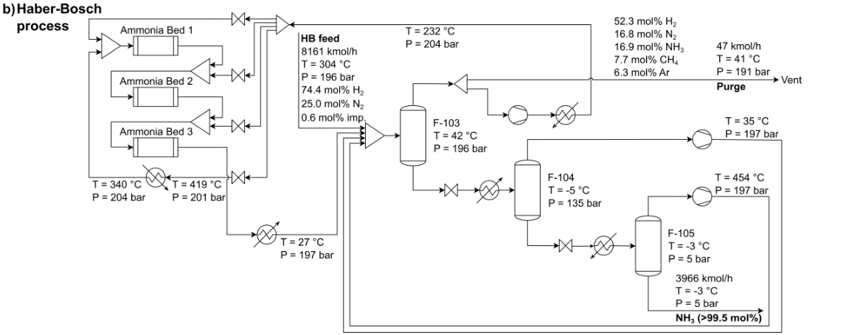
Haber Bosch process for the production of ammonia
Can use hydrogen from electrolysis i.e., green hydrogen

Slide 5
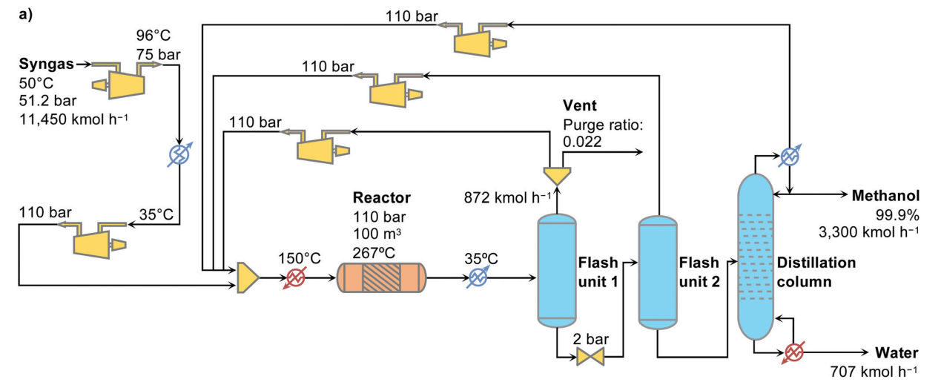
Conventional process for methanol production

Slide 6
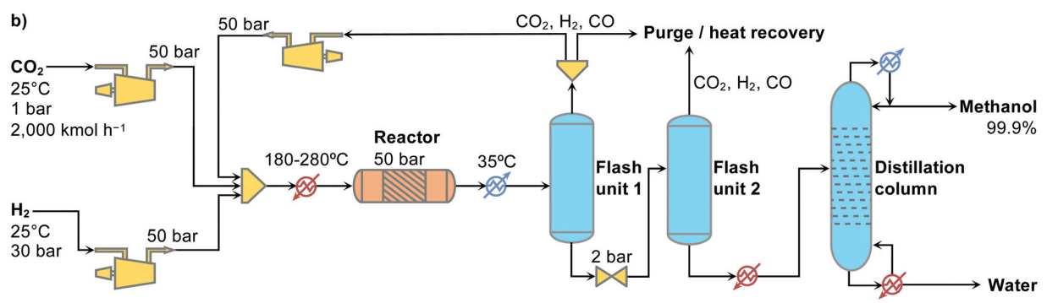
Green alternative for methanol production

Slide 7
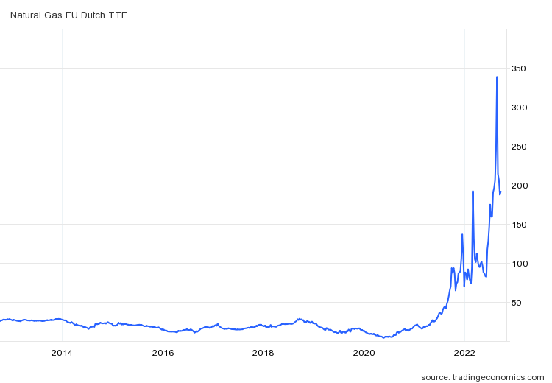
Natural gas prices – current scenario in EUR/MWh
Currently, natural gas prices are five times the average of 2021 (40 EUR/MWh).
It reached a high price of 345 EUR/MWh in 2022.
Green routes v conventional routes.
For NG, 1 EUR/MWh = 13.1 EUR/t

Slide 8
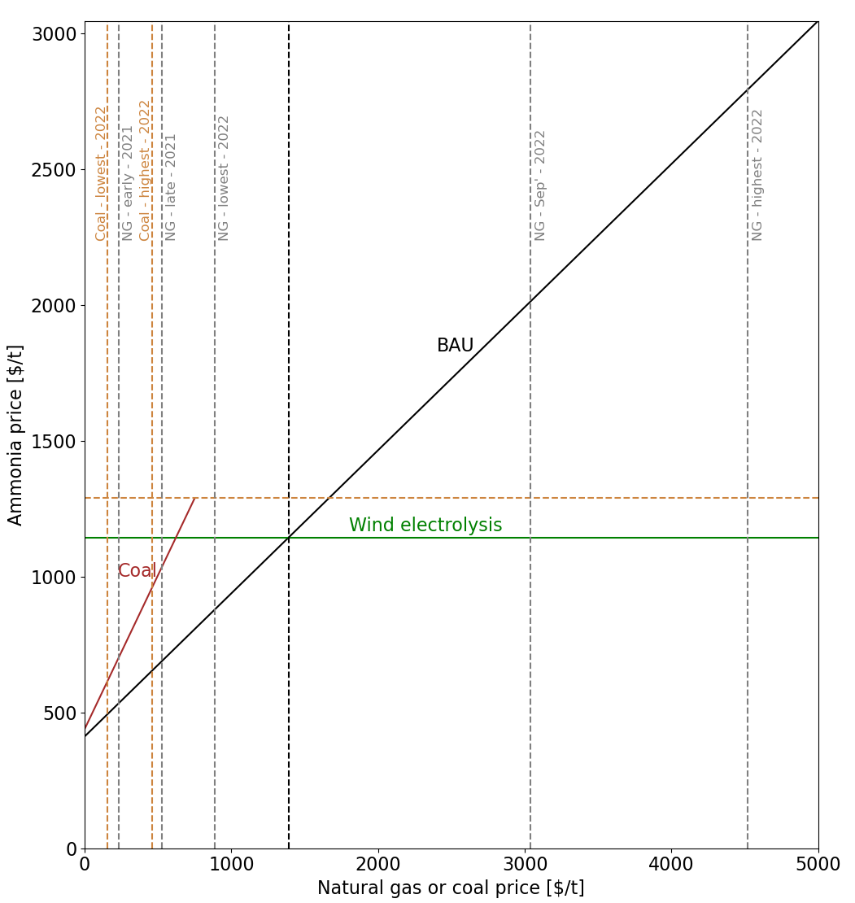
Hydrogen from wind electrolysis is economically a better option in the current scenario…

Slide 9
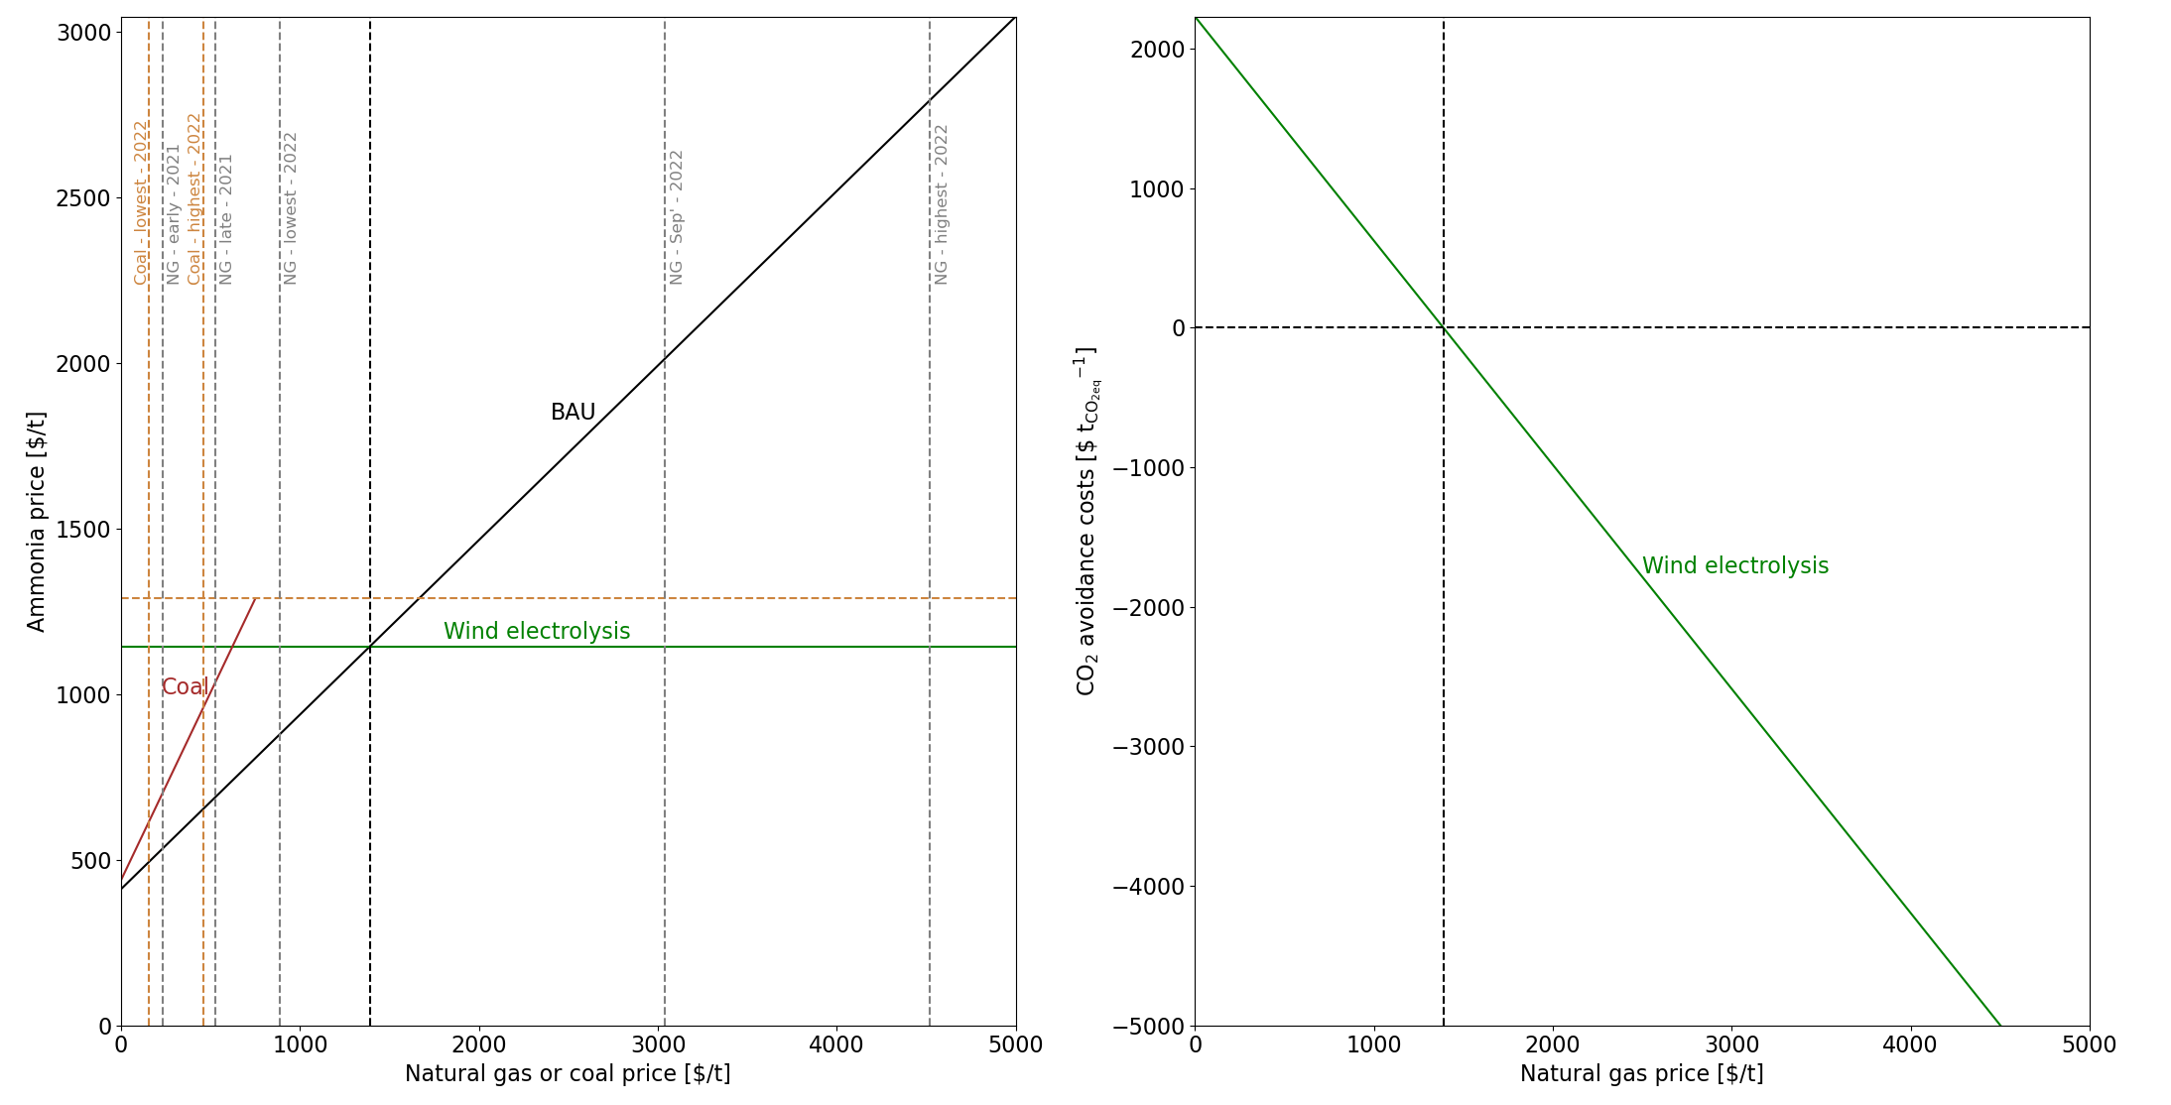
Hydrogen from wind electrolysis is economically a better option in the current scenario…

Slide 10
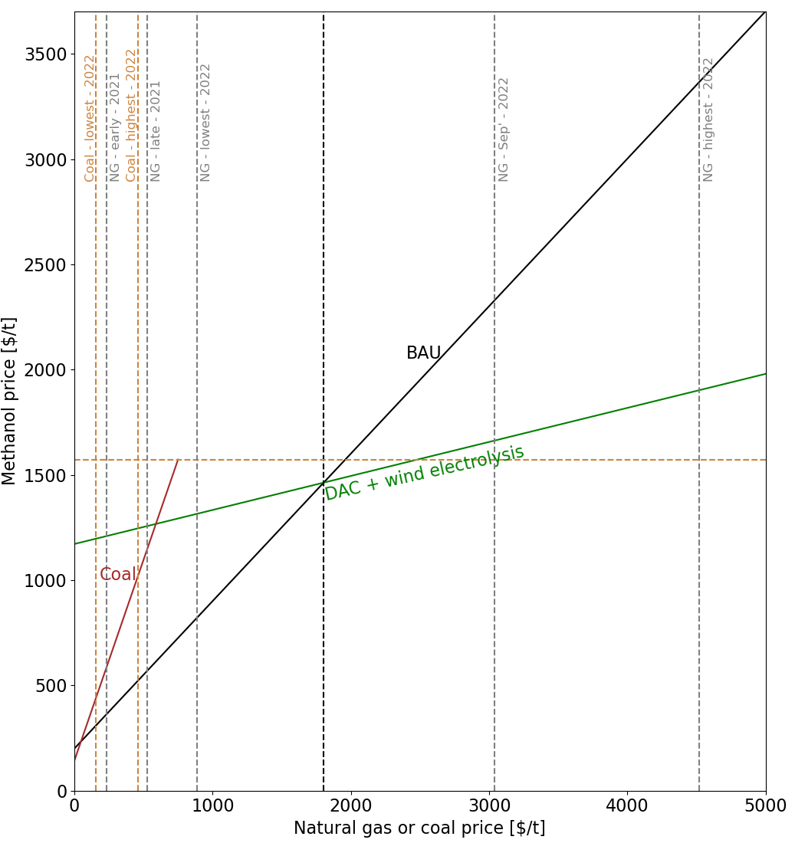
Simlarly for methanol, green routes perform better economically…

Slide 11
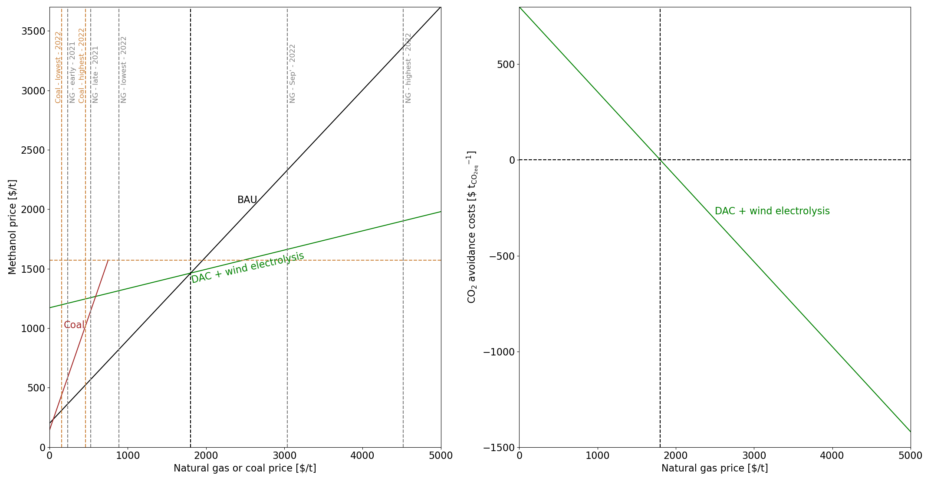
Simlarly for methanol, green routes perform better economically…

Slide 12
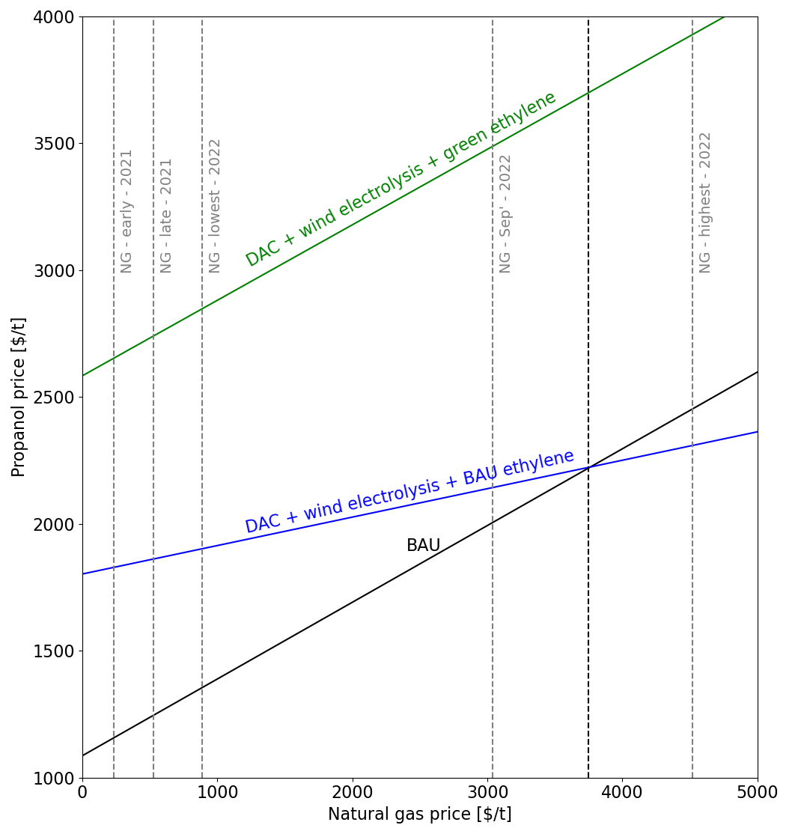
For propanol, complete green routes are not yet better than the BAU route…

Slide 13
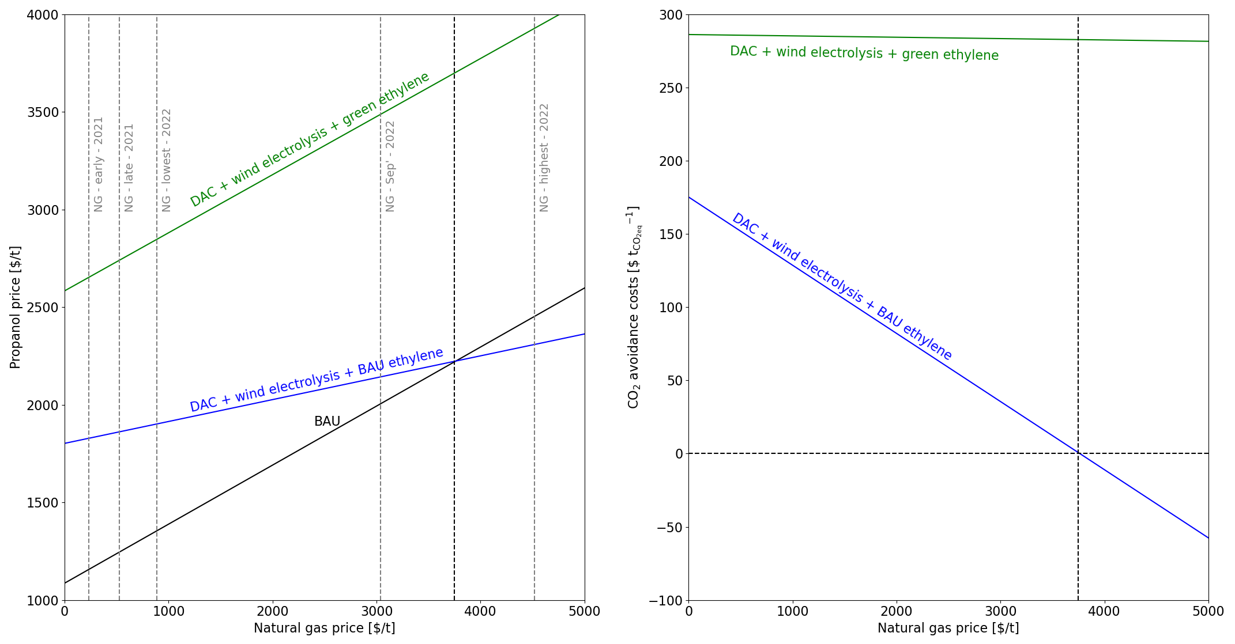
For propanol, complete green routes are not yet better than the BAU route…

Slide 14
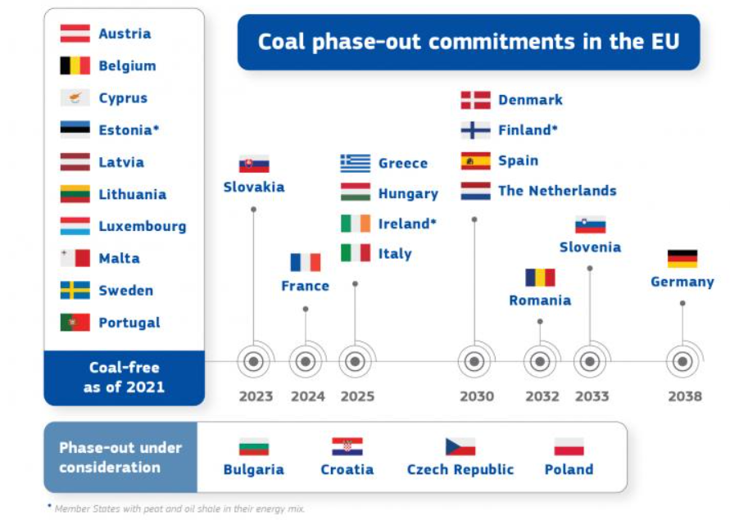
Coal is not a threat!
One could argue that coal gasification is a cheaper option.
However, EU has decided to phase out coal usage by 2031.
93% of the coal is used for the energy sector.

